Slide 1
Module 15
Marketing Strategies for New Markets
By: Dr Shahinaz Abdellatif

Slide 2
Objective of this session
1. To discuss the major strategic issues in new markets

Slide 3
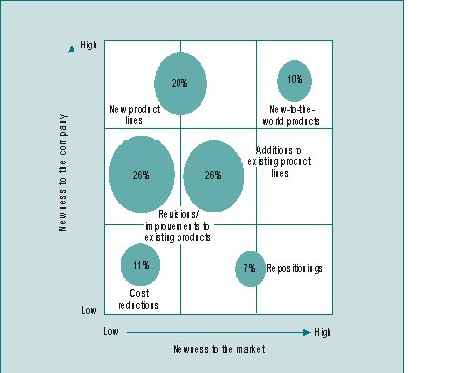
New Products

Slide 4
How new is new?
New-to-the-world products – True innovations that are new to the firm and create an entirely new market (10 per cent).
New product lines – A product category that is new for the company introducing it, but not new to customers in the target market because of the existence of one or more competitive brands (20 per cent).
Additions to existing product lines – New items that supplement a firm’s established product line. These items may be moderately new to both the firm and the customers in its established product-markets. They also may serve to expand the market segments appealed to by the line (26 per cent).

Slide 5
How new is new?
Improvements in or revisions of existing products – Items providing improved performance or greater perceived value brought out to replace existing products. These items may present moderately new marketing and production challenges to the firm, but unless they represent a technologically new generation of products, customers are likely to perceive them as similar to the products they replace (26 per cent).
Repositionings – Existing products that are targeted at new applications and new market segments (7 per cent).
Cost reductions – Product modifications providing similar performance at lower cost (11 per cent).

Slide 6
Sources of Competitive Advantage
- Pioneer & Advantage
Pioneer Follower
Economics of scales and experience.
High switching costs for early adopters.
Pioneer defines the rules of the game.
Distribution advantage.
Influence on consumer choice criteria and attitudes.
Possibility of pre-empting scarce resources.
Ability to take advantage of pioneer’s positioning mistakes.
Ability to take advantage of pioneer’s product mistakes.
Ability to take advantage of pioneer’s marketing mistakes.
Ability to take advantage of the latest technology.
Ability to take advantage of pioneer’s limited resources.

Slide 7
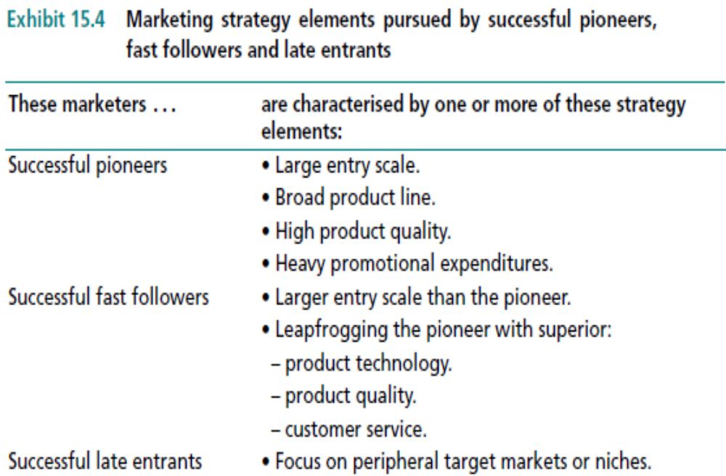
Marketing strategy elements

Slide 8
Pioneer - Strategic Marketing Programmes
Mass market penetration
Niche penetration
Skimming/early withdrawal strategy

Slide 9
Pioneer - Mass Market Penetration
Overall objective
  capture and maintain share of the total market for the new product
Marketing objective
  maximise customer adoption programme asap
Strategy
  increase customer’s awareness and willingness to buy
  make it easy for people to buy

Slide 10
Pioneer - Niche Penetration
Overall objective
  capture and maintain share of single segment of the market for the new product
Marketing objective
  maximise customer adoption programme asap in a single segment
Strategy
  increase customer’s awareness and willingness to buy
  make it easy for people to buy

Slide 11
Pioneer - Skimming; Early Withdrawal
Overall objective
  recoup development costs asap
Marketing objective
  maximise customer adoption programme asap in those segments least sensitive to price
Strategy
  increase customer’s awareness and willingness to buy (least price sensitive groups)
  make it easy for people to buy (but watch margins)

Slide 12
Strategic Market program for Pioneers
Objective:
  Increase customers’ awareness and willingness to buy.
  Increase customers’ ability to buy

Slide 13
Strategic Market program for Pioneers
Objective:
  Increase customers’ awareness and willingness to buy.
  Increase customers’ ability to buy

